Slide 1
Modeling Mortgage Credit Availability
September 2015

Slide 2
Commonly Cited Measures of Credit Availability
1
HPA Index
Two Year Seasonal Adjustment Index
2
Purchase Index
By the Mortgage Bankers Association (MBA)
3
FICO Distribution Measure
Borrower’s credit score distribution at origination

Slide 3
Commonly Cited Measures of Credit Availability
1
HPA Index
Pros: Capture the macroeconomic conditions.
Two Year Seasonal Adjustment Index
Cons: Cannot capture the changes in underwriting criteria.
Macroeconomic
Underwriting Criteria
2
Purchase Index
Pros: Takes many factors into account (loan purpose, property type), large number of lenders.
By the Mortgage Bankers Association (MBA)
Cons: Lacks transparency. There is no way for us to know how numbers are assigned to these factors, and convert the factors into one single number.
Many Factors
Transparency
3
FICO Distribution Measure
Pros: Intuitively reflects the amount of risk the market is willing and expected to take.
Borrower’s credit score distribution at origination
Cons: Credit score alone is insufficient (LTV, DTI, etc. also matter). Tail or median cannot cover the distribution information.
Amount of Risk
Cover the distribution

Slide 4
Default Risk Measure
Do we have a better way?
Macroeconomic
Macroeconomic
Underwriting Criteria
Underwriting Criteria
Many Factors
Many Factors
Transparency
Transparency
Amount of Risk
Amount of Risk
Cover the distribution
Cover the distribution
Default Risk Measure
Default Risk Measure
1.Sample population
All 30-year FHLMC/ FNMA loans that are originated in a given month
Measure the amount of default risk the market takes on at a given time based on a set of prescribed typical macroeconomic conditions.
2.Credit Availability Metric
Calculate the expected cumulative default rate for the sample population over 3 years using Accordion
3.Macroeconomic Scenario Assumptions
There is a normal environment with a probability weight of 90% and a stressed environment with a weight of 10%.
Environment | Mortgage Rates | HPI
Normal | No changes | Increases of 3% per year for 3 years
Stressed | 1 year: Unchanged, 2 years: Declines of 25 bps per year | 2 years: Declines of 13% per year 1 year: Flat house prices
4. Mortgage Credit Availability Index
Create a time-series of expected cumulative default rates as per the specified assumptions for each month based on the collateral characteristics of the loans originated that month.

Slide 5
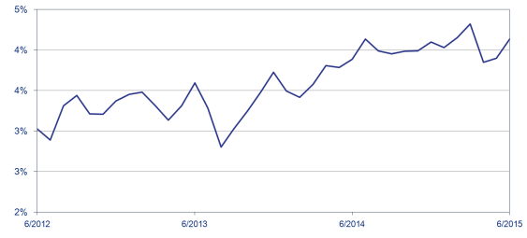
Calculating Mortgage Credit Availability
loanID
firstPaymtDt
origNoteRate
origLoanAmt
origTerm
origPayment
origLTV
origValue
origDTI
origFICO
pctMtgIns
firstTimeBuyer
numBorrowers
numUnits
loanPurpose
propertyType
occupancyStatus
loanType
docType
origServicer
Re-organize the loan data according to the origination month
Inputs
Loan Level
DB
Monthly
Monthly
Orig.
Data
Inputs
Outputs
Expected Cumulative Default Rate
Accordion
All FNMA & FHLMC 30-year conventional loan level data
All loan data in a given origination month
Expected
Default Rate Model
Calculation
Result series for the sample population over 3 years
Cover the distribution
Underwriting Criteria
Many Factors
Amount of Risk

Slide 6
Calculating Mortgage Credit Availability
Macroeconomic Scenario Assumptions
Normal Environment
90%
Expected Cumulative Default Rate
Outputs
Assign
Stressed Environment
10%
Environment | Mortgage Rates | HPI
Normal | No changes | Increases of 3% per year for 3 years
Stressed | 1 year: Unchanged, 2 years: Declines of 25 bps per year | 2 years: Declines of 13% per year 1 year: Flat house prices
Macroeconomic

Slide 7
Expected Cumulative Default Rate
Weighted Average Expected Cumulative Default Rate
After the calculation process, we get the weighted average value of Expected Cumulative Default Rate, which is the mortgage credit availability under default risk measure.

Slide 8
Mortgage Credit Availability Index
Mortgage Credit Availability Index
In order to make the credit availability easier for users to understand, we change this expect cumulative default rate into a single index number. The index uses 3% default rate as benchmark, and measures the shift from benchmark value.
$$Index=(\frac{Expected Cumulative Default Rate−3\%}{3\%}+1) ×100$$

